Slide 1
بهینه‌سازی سرعت

Slide 2
معیارهای بهینه‌سازی
تحلیل مدارهای ترکیبی
تحلیل مدارهای ترتیبی

Slide 3
Delay characteristics
Measured from change in inputs to change in outputs.
Data-dependent:
Some block delays depend on the value/waveform at the input (t_{pHL} ≠ t_{pLH}) (t_{r} ≠ t_{f})
May need to observe different paths through the network.

Slide 4
Timing diagram
A
B
time

Slide 5
Sources of Delay
Logic delay:
Little we can do about it
E.g. select another FPGA with faster logic blocks (LBs) or
Minimize the number of LBs in the critical path
Wire delay:
Much we can do
E.g. select the proper path of the wire or
Select buffered paths.

Slide 6
Fanout
Fanout adds capacitance.
sink
source
sink
sink

Slide 7
Driving fanout
Adding gates adds capacitance:

Slide 8
Path delay
Combinational network delay:
Measured over paths through network.
Can trace a causality chain from inputs to worst-case output.

Slide 9
Delay model
Graph model:
Nodes represent gates.
Assign delays to edges:
Signal may have different delay to different sinks.
Lump gate and wire delay into a single value.

Slide 10
Path delay example
network
graph model

Slide 11
Critical path
Critical path = path which creates longest delay.
Can trace transitions which cause delays that are elements of the critical delay path.

Slide 12
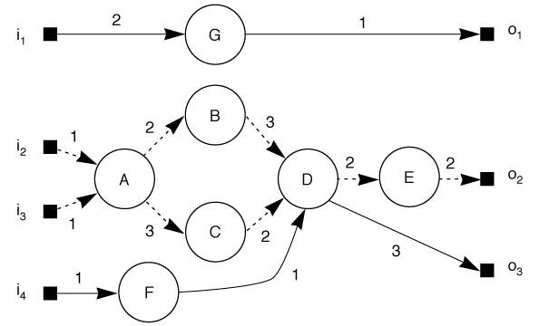
Critical path through delay graph

Slide 13
Reducing critical path length
Must speed up the critical path
Reducing delay off the path doesn’t help.
There may be more than one path of the same delay.
→ Must speed up all equivalent paths to speed up circuit.
Cutset:
A set of edges that when removed, break the graph into two unconnected paths. (e.g. {(C,D), (B,D)} or {(D,E)}
→ Must speed up cutset through critical path.

Slide 14
Delay Paths in a design

Slide 15

Unbalanced delays
Logic with unbalanced delays leads to inefficient use of logic:
short clock period
long clock period

Slide 16
Flip-flop-based system model
Assumptions:
Clock signal is perfect (no rise/fall), period T_{clock}
Clock event on rising edge
Setup time: t_{su}
Time required for the FF input to be stable before active edge of clock
Propagation time t_{co}
Time for value to go from FF input to output (from clock edge)
Worst-case combinational delay t_{critical}
Time from output of FF to input of this/other FFs

Slide 17
Flip-flop-based system performance analysis
T_{clock} > t_{co} + t­_{critical} + t_{su}

Slide 18
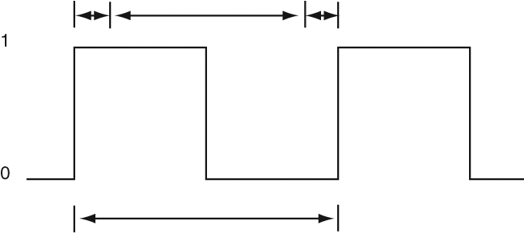
Clock parameters
t_{co}
t_{critical}
t_{su}
T_{clock}

Slide 19
Skew
Skew
relative delay between events
Clock skew
can produce error in any sequential system.

Slide 20
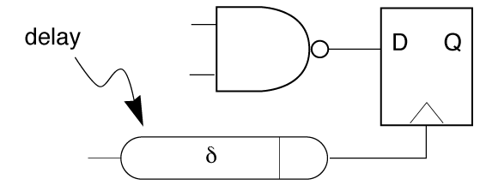
Clock skew
Clock must arrive at all memory elements in time to load data.

Slide 21
Clock skew in system
D
Q
logic
δ
D
Q

Slide 22
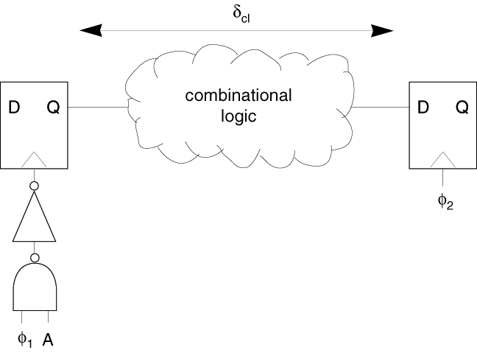
Clock skew and gated clocks
Clk
Clk

Slide 23
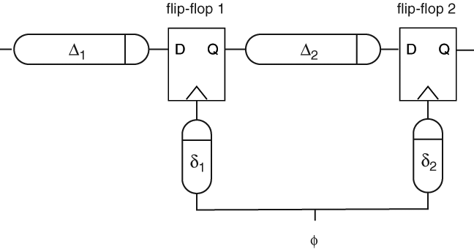
Clock skew analysis model
s₁₂ = δ₁ – δ₂
Assume δ₁ > δ₂ (s₁₂ > 0)
φ

Slide 24
Skew and clock period
Assume: each flip-flop operates instantaneously
If clock arrives at FF1 after FF2, then there is less time for the signal to propagate through the combinational logic.
Determine clock period:
T_{clock} >= Δ₂ ₊ s₁₂
T_{clock} > t_{co} + t­_{critical} + t_{su} + t_{skew,max}

Slide 25
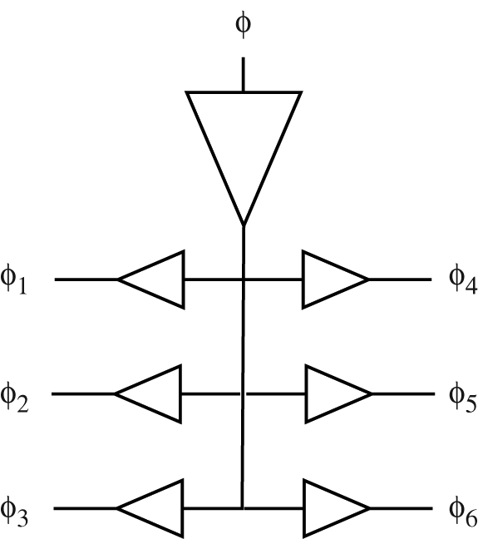
Clock distribution
Clock design:
Fast edges
Minimum skew

Slide 26
Clock skew example
D
D
Q
Q
D
Q
10 ps
10 ps
20 ps
20 ps
30 ps
D
Q
30 ps

Slide 27
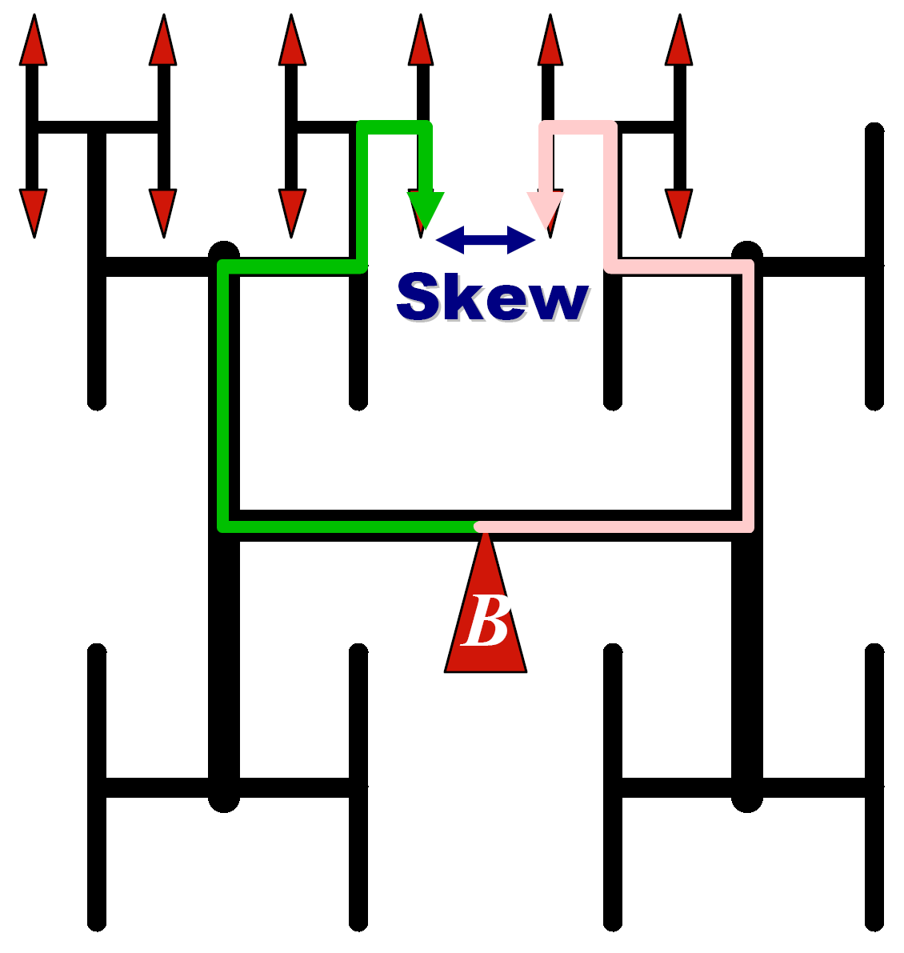
Clock H-Tree

Slide 28
False paths
Some input changes don’t cause output changes.
False path:
A path which never happens due to Boolean gate conditions.
Cause pessimistic delay estimates.

Slide 29
False path example

Slide 30
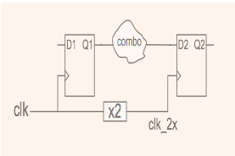
Multi-Cycle paths
Some combinational paths from a FF to another have more time than a clock cycle.
Example:
Two-clock system

Slide 31
Multi-Cycle paths
Example:
Single-clock system

Slide 32
Placement and delay
Placement helps determine gate distances.
Gate distances determine routing.
Routing determines wire length.
Wire length determines capacitive load.
Capacitive load determines delay.

Slide 33
Placement and wire capacitance
g1
g3
dvr
g2
g4
g1
g3
dvr
g2
g4

Slide 34
Optimizing network delay
Identify the longest path(s).
Improve delay along the longest path(s):
Driver delay
Wire delay
Logic restructuring
NET "data_out_1_OBUF"
ROUTE="{3;1;6slx25csg324;477afbc1!-1;8040;6064;S!0;-845;-504!1;0;344!1;" "-9743;1431!2;845;144;L!3;-16261;1!5;-22484;-4!6;-17991;3!7;-12477;5681!8;"
"0;12800!9;0;12800!10;0;12800!11;0;13872!12;0;12800!13;0;12800!14;0;12800!" "15;0;13872!16;305;7589!17;0;3200!18;1855;1675!19;686;18!20;80;20!21;" "-
1490;2207!22;-1311;251;L!}";
NET "data_out_1" LOC=D6;
INST "data_out_1_OBUF" LOC=SLICE_X29Y41;
INST "data_out_1" LOC=SLICE_X29Y41;

Slide 35
Example: Adder placement and delay
N-bit adder: (optimal placement)
+
+
+
+

Slide 36
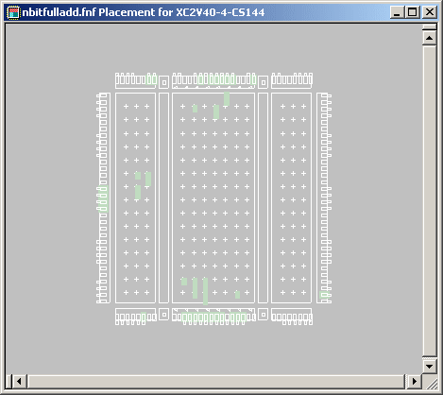
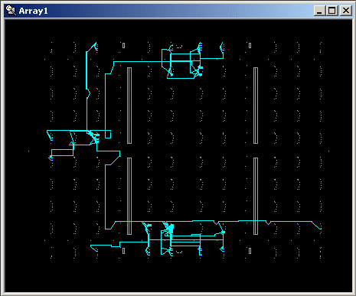
Bad placement and routing
With no delay constraints.
placement
routing

Slide 37
Bad placement and routing
Adder has been distributed throughout the FPGA.
I/O pins have been spread around the chip.
→ P&R algorithms do not catch on regularity.

Slide 38
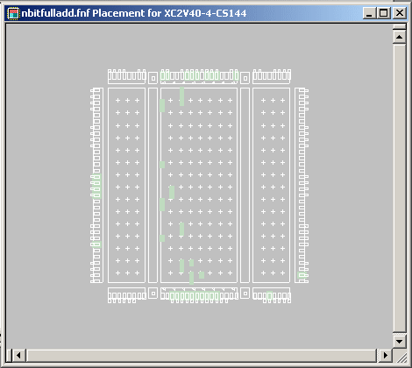
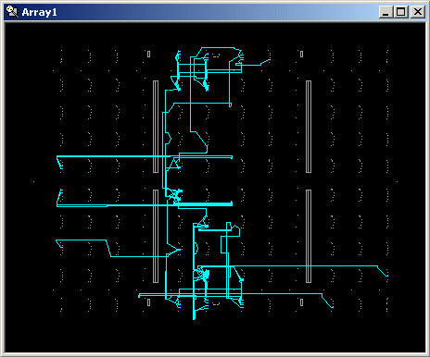
Better placement and routing
With delay constraints.
Better but far from optimal (less spread out horizontally but spread out vertically)

Slide 39
How to improve?
Use macros (optimized)
Use proper constraints
Objective
Proper pin assignment
Floorplan
Put constraints on the placement of objects
Hand place objects

Slide 40
Design experiments
Synthesize with no constraints.
Synthesize with timing constraint.
Tighten timing constraint.
Synthesize with placement constraints.

Slide 41
Commercial Tools
XST “-power” option
reduces dynamic power consumption.
Xilinx MAP and PAR“-power” option
reduces dynamic power
But increases runtime and decreases design performance.
Quartus-II
has Power-Driven Synthesis and Place & Route.

Slide 42
Mapping report
Case study:
16 x 16 multiplier
Combinational circuit
No timing or area constraints
Design Summary
--------------
Number of errors: 0
Number of warnings: 0
Logic Utilization:
Number of 4 input LUTs: 501 out of 1,024 48%
Logic Distribution:
Number of occupied Slices: 255 out of 512 49%
Number of Slices containing only related logic: 255 out of 255 100%
Number of Slices containing unrelated logic: 0 out of 255 0%
Total Number 4 input LUTs: 501 out of 1,024 48%
Number of bonded IOBs: 64 out of 92 69%
Total equivalent gate count for design: 3,006
Additional JTAG gate count for IOBs: 3,072
Peak Memory Usage: 64 MB

Slide 43
Static timing analysis report
Timing constraint: TS_P2P = MAXDELAY FROM TIMEGRP "PADS" TO TIMEGRP "PADS" 99.999 uS ;
20135312 items analyzed, 0 timing errors detected. (0 setup errors, 0 hold errors)
Maximum delay is 20.916ns.
--------------------------------------------------------------------------------
After Mapping: → estimated delays
(no information about interconnects)

Slide 44
Static timing report: delays along paths
Data Sheet report:
-----------------
All values displayed in nanoseconds (ns)
Pad to Pad
------------------+----------------------+-----------+
Source Pad |Destination Pad| Delay |
------------------+----------------------+-----------+
x<0> |p<0> | 5.824|
x<0> |p<10> | 10.675|
x<0> |p<11> | 11.214|
x<0> |p<12> | 11.753|

Slide 45
Routing report
Phase 1: 1975 unrouted; REAL time: 11 secs
Phase 2: 1975 unrouted; REAL time: 11 secs
Phase 3: 619 unrouted; REAL time: 12 secs
Phase 4: 619 unrouted; (0) REAL time: 12 secs
Phase 5: 619 unrouted; (0) REAL time: 12 secs
Phase 6: 619 unrouted; (0) REAL time: 12 secs
Phase 7: 0 unrouted; (0) REAL time: 12 secs
The NUMBER OF SIGNALS NOT COMPLETELY ROUTED for this design is: 0
REAL time: Routing algorithm run time.

Slide 46
Static timing after routing
Timing constraint: TS_P2P = MAXDELAY FROM TIMEGRP "PADS" TO TIMEGRP "PADS" 99.999 uS ;
20135312 items analyzed, 0 timing errors detected. (0 setup errors, 0 hold errors)
Maximum delay is 38.424ns.
-------------------------------------------------------------------
(vs. 20.916 ns in mapping report) Because of interconnect delays.

Slide 47
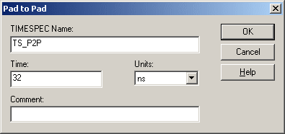
Timing constraint
Use timing constraint editor:

Slide 48
Post-map static timing report
Timing constraint: TS_P2P = MAXDELAY FROM TIMEGRP "PADS" TO TIMEGRP "PADS" 32 nS ;
20135312 items analyzed, 0 timing errors detected. (0 setup errors, 0 hold errors)
Maximum delay is 20.916ns.
Pad to pad
Hasn’t changed since this design has limited opportunities for logic synthesis to change delays by restructuring logic.

Slide 49
Post-routing static timing report
Timing constraint: TS_P2P = MAXDELAY FROM TIMEGRP "PADS" TO TIMEGRP "PADS" 32 nS ;
20135312 items analyzed, 0 timing errors detected. (0 setup errors, 0 hold errors)
Maximum delay is 31.984ns.
Tools generally try to meet the delay goal as closely as possible to minimize area.

Slide 50
Tighter timing constraints
Tighten requirement to 25 ns.
Post-place-route timing report:
Timing constraint: TS_P2P = MAXDELAY FROM TIMEGRP "PADS" TO TIMEGRP "PADS" 25 nS ;
20135312 items analyzed, 11 timing errors detected. (11 setup errors, 0 hold errors)
Maximum delay is 31.128ns.

Slide 51
Report on a violated path
Slack: -6.128ns (requirement - data path)
Source: y<0> (PAD)
Destination: p<30> (PAD)
Requirement: 25.000ns
Data Path Delay: 31.128ns (Levels of Logic = 31)
Modify the logic and/or physical design to improve the delay.

Slide 52
Power report
Power summary: I(mA) P(mW)
----------------------------------------------------------------
Total estimated power consumption: 333
---
Vccint 1.50V: 0 0
Vccaux 3.30V: 100 330
Vcco33 3.30V: 1 3
---
Inputs: 0 0
Logic: 0 0
Outputs:
Vcco33 0 0
Signals: 0 0
---
Quiescent Vccaux 3.30V: 100 330
Quiescent Vcco33 3.30V: 1 3
Thermal summary:
----------------------------------------------------------------
Estimated junction temperature: 36C
Ambient temp: 25C
Case temp: 35C
Theta J-A: 34C/W
Helps us determine whether we need additional cooling.

Slide 53
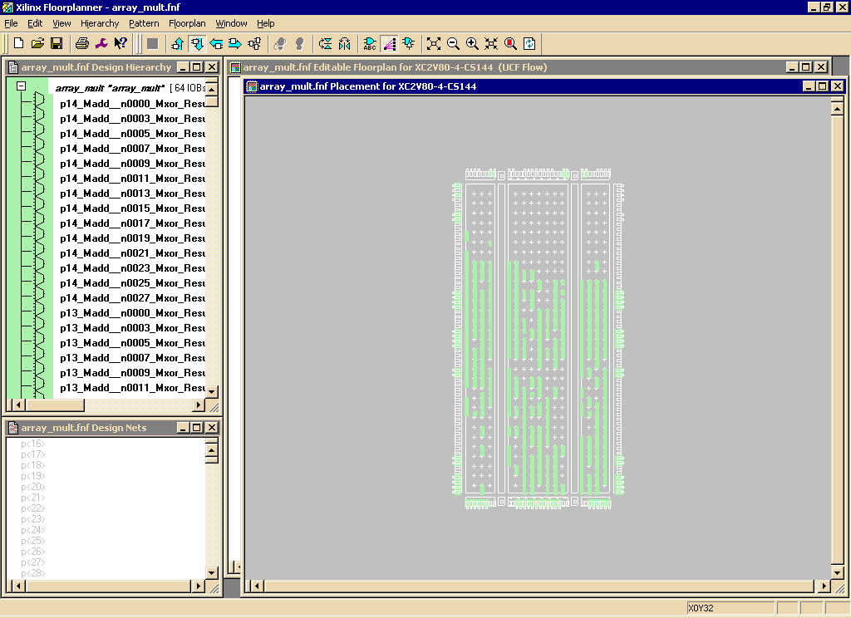
بهبود سرعت با جاسازی
Floorplanner window:
Floorplanner → View/edit placed design
LEs
Green rectangles: mapped components to CLBs

Slide 54
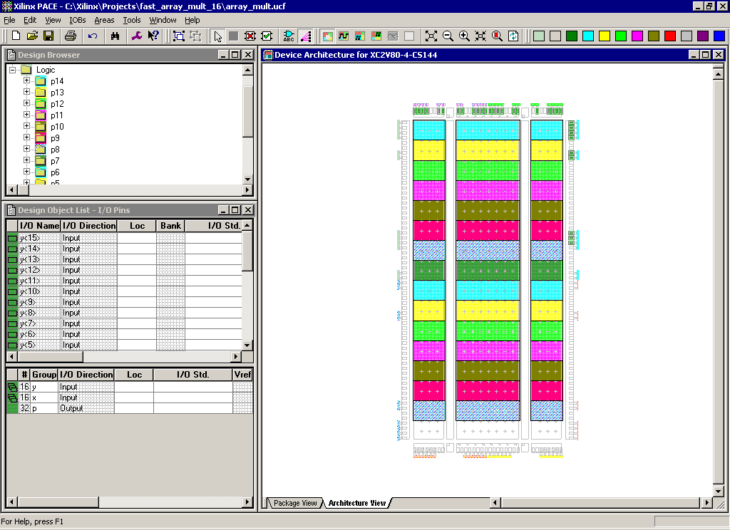
جاسازی
طرح منظم ← ساختار مداری منظم
در طرح مسطح، ابزار فاقد اطلاعات نظم طرح است

Slide 55
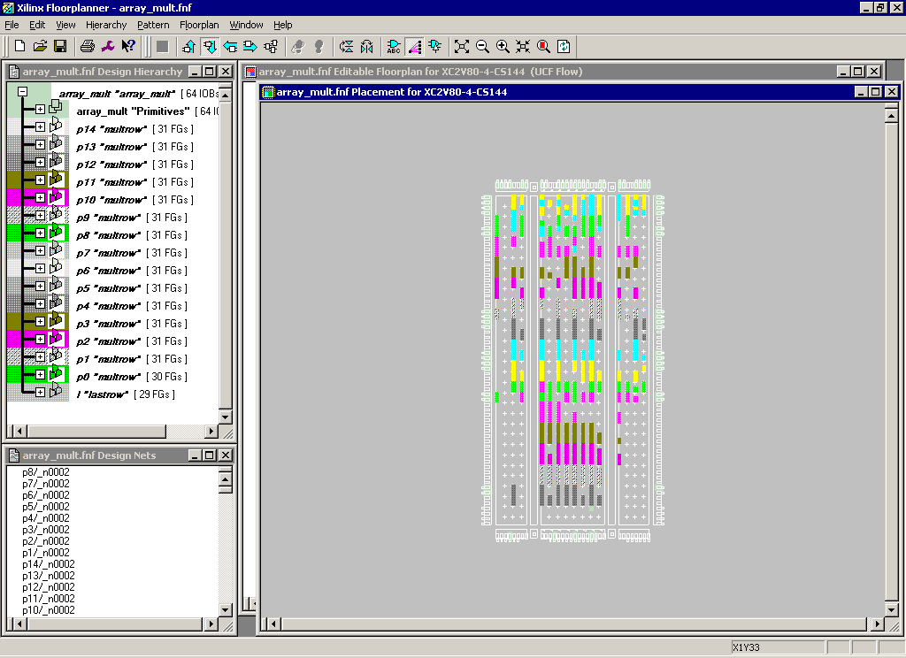
جاسازی
نتیجة جایابی

Slide 56
جاسازی
گزارش ابزار جایابی و مسیریابی:
19742142 items analyzed, 0 timing errors detected. (0 setup errors, 0 hold errors)
Maximum delay is 29.934ns.
مقایسه با 31.128 بدون جاسازی

